Slide 1
Cloud native pipelines distribution

Slide 2
Distribution overview
Cloud Native Pipelines
Customer’s target solution
DevOps Project
DevOps Project
Azure Cloud resources
Pipelines
Pipelines
VNET
Terraform modules
Terraform modules
ACR
Documentation
Documentation
AKS
Artifact.zip
Manual run
KeyVault etc.
Application Project
Application Project
Pipelines
Pipelines
Application deployment
Documentation
Documentation

Slide 3
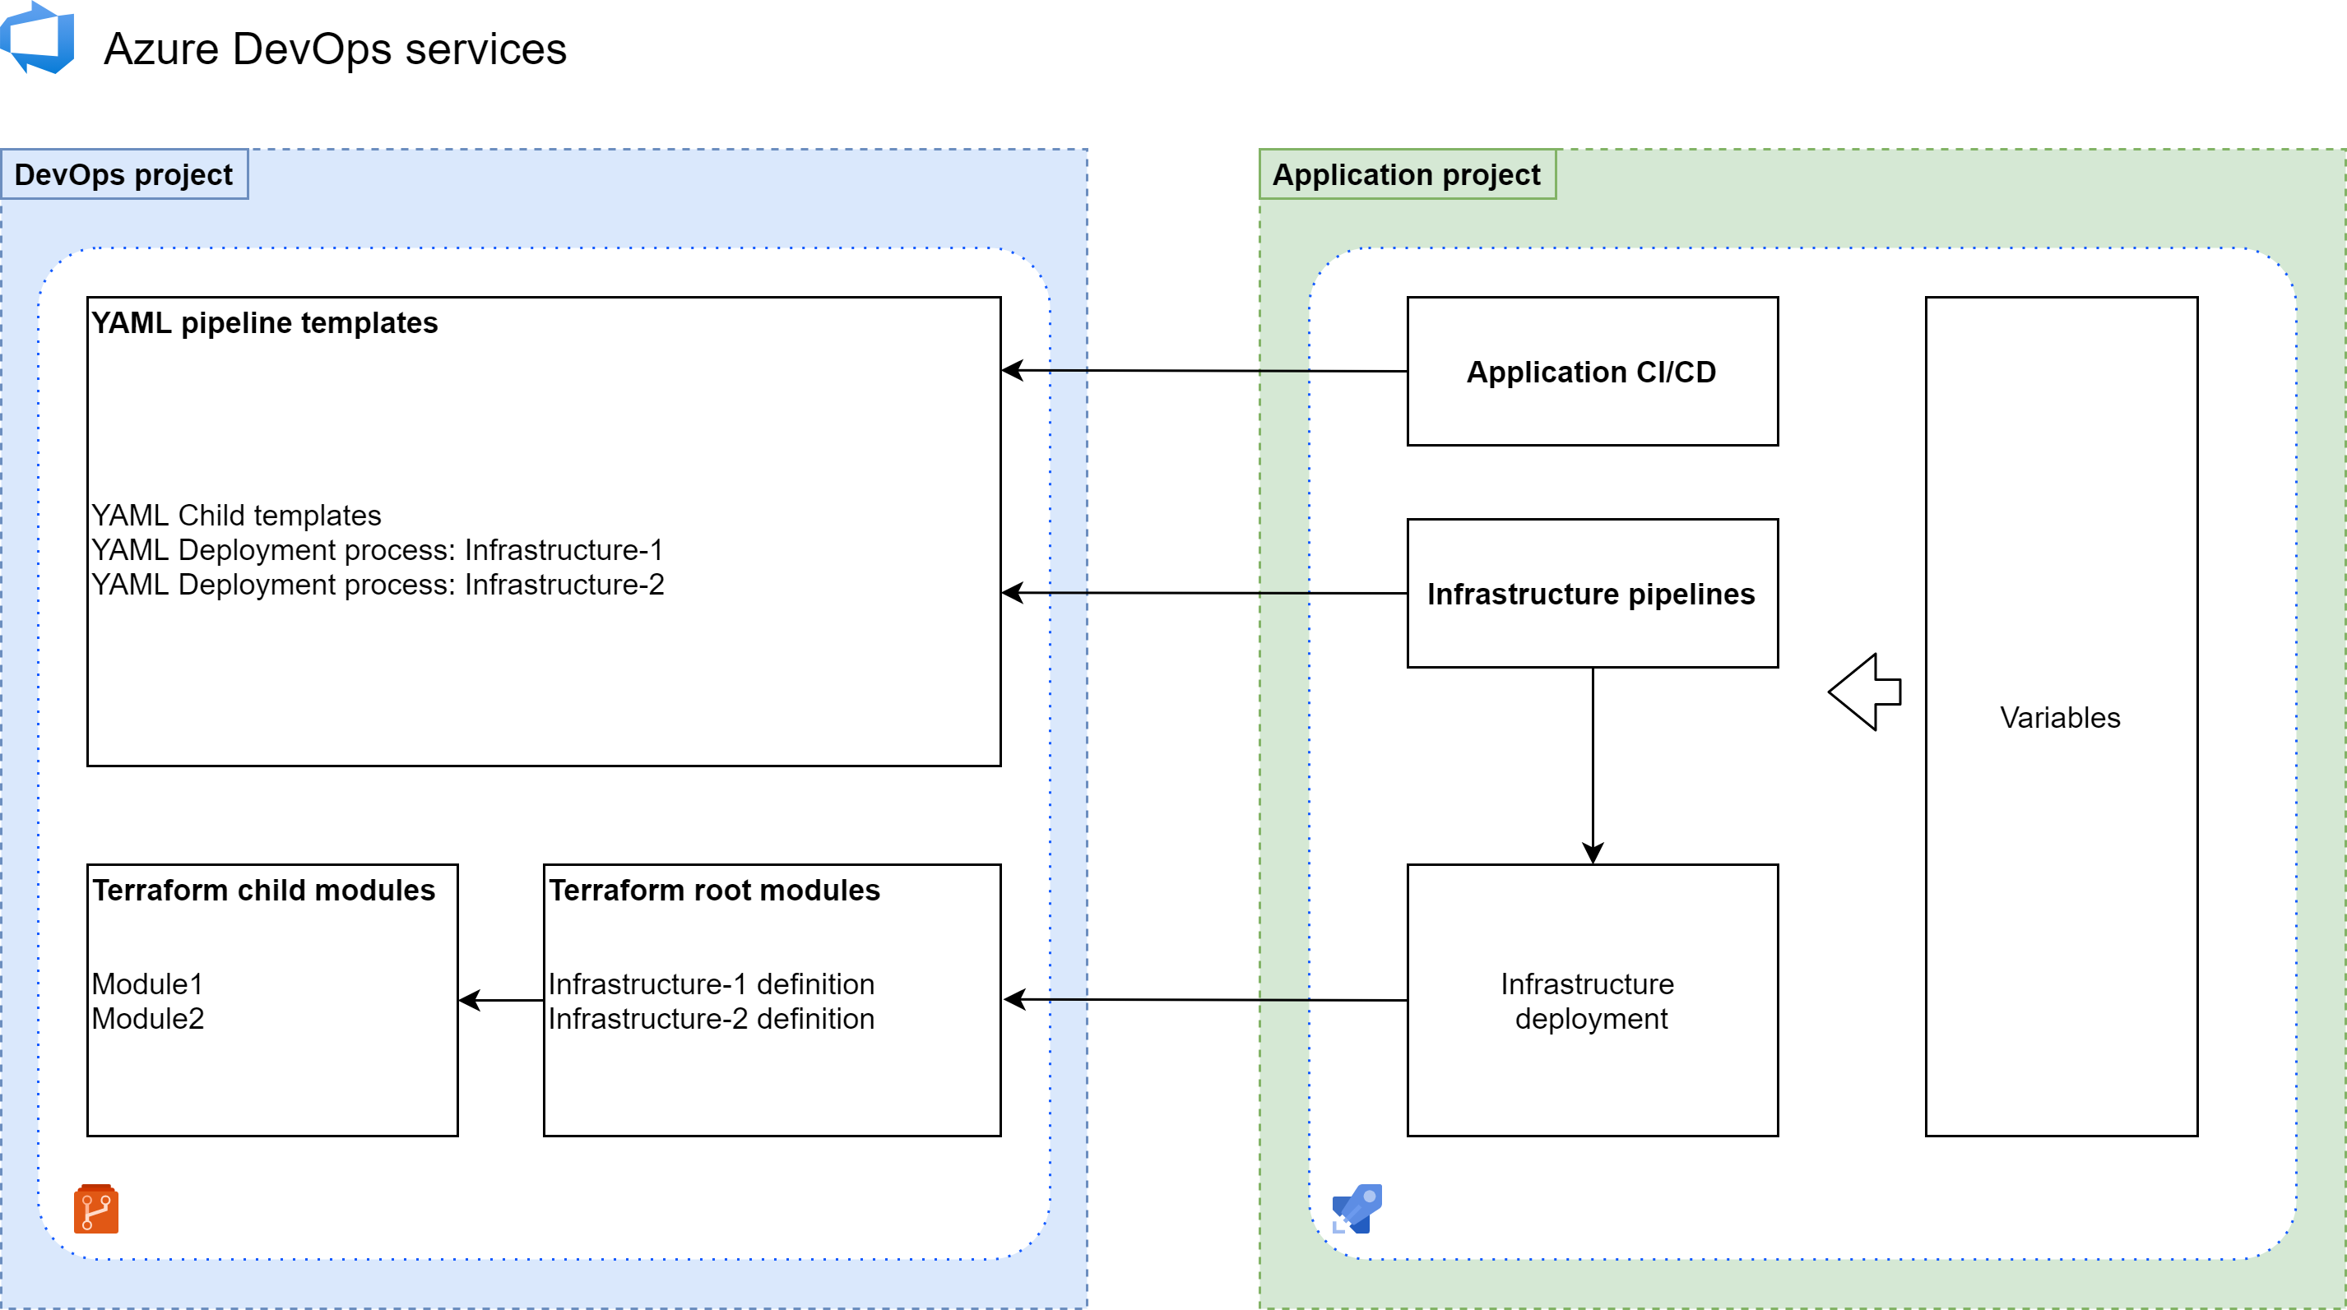
Projects referencing

Slide 4
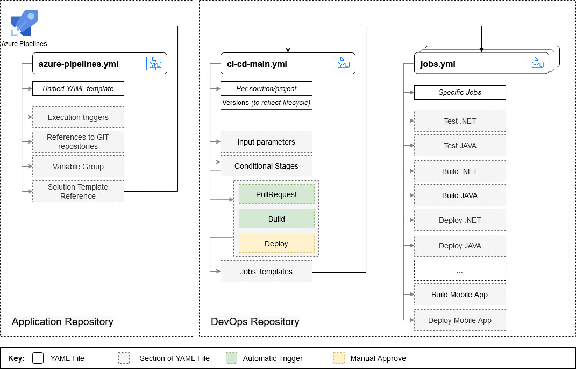
Reference CI/CD pipeline

Slide 5
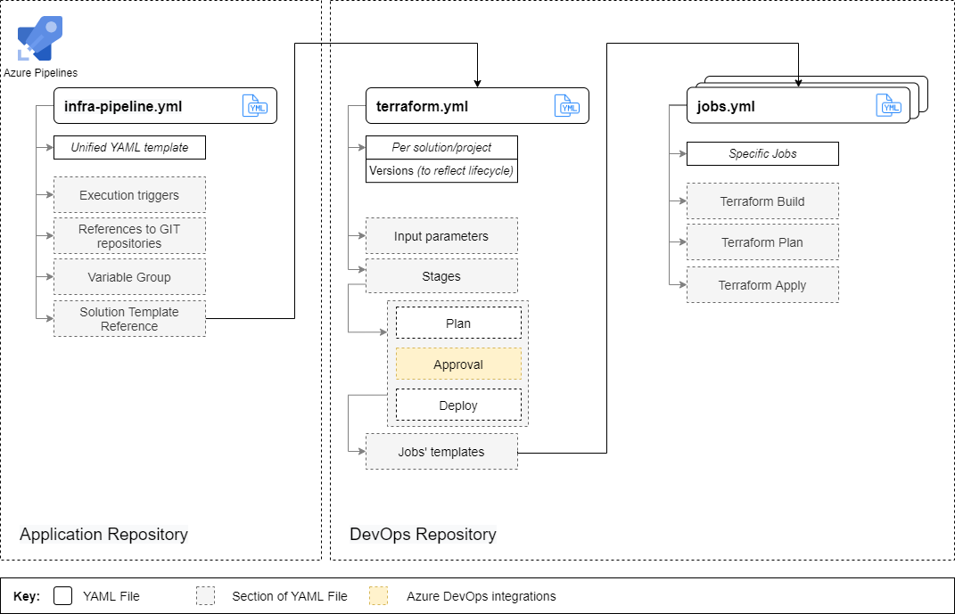
Reference IaC pipeline

Slide 6
Our clients
OneCallMedical
HarperCollins

Slide 7
DEMO

Slide 8

Thank you!

